Slide 1



Recognition of Vehicle Number Plate System using Matlab
Sanmugavel R (20215040 36) Dr.G.Sumithra,
Karthikeyan B (2021504014) Associate Professor
Jayanth (2021504523) Dept of Electronics Engineering,
B.E , 4th Semester , ECE Madras Institute of Technology
Dept of Electronics Engineering,
Madras Institute of Technology Mehar Nisha Begum ,
Anna University. Teaching Fellow
Dept of Electronics Engineering,
Madras Institute of Technology

Slide 2
ABSTRACT
Tracking the number plate of the vehicle is an important task in traffic surveillance.
Matlab is used for number plate extraction from an input image and for recognizing the number plate characters.
An RGB image is taken. After extracting the number plate region from the input image, edge detection is carried to identify each character in the number plate.

Slide 3
INTRODUCTION
Number plates are used for identification of vehicles all over the nations.
Vehicles are identifying either manually or automatically.
Automatic vehicle identification is an image processing technique of identify vehicles by their number plates.
Automatic vehicle identification systems are used for the purpose of effective traffic control and security applications such as access control to restricted areas and tracking of wanted vehicles.
Number plate recognition is easier method for Vehicle identification

Slide 4
Method of operation
Extracting the plate region
Segmentation of charactres
Pre-processing the Image
Display the output

Slide 5
Preprocessing the image:
For the better performance of character segmentation pre-processing is a very important. Here we have performed three basic steps in pre-processing module which are RGB to gray conversion and gray to binary conversion.
Matlab Functions used here,
imread() – This command is used to open the image into the MATLAB from the target folder.
rgb2gray() –This command is used to convert the RGB image into grayscale format.
imbinarize() – This command is used to Binarize 2-D grayscale image or simply we can say it converts the image into black and white format.

Slide 6
Extracting the plate region:
In order to identify the characters, we need to extract the number plate from the picture. Also, the unwanted parts of the image that are connected to the border of the number plate must be removed.
The following Matlab functions are used to detect and extract the region of interest.
edge() – This command is used to detect the edges in the image, by using various methods like Roberts, Sobel, Prewitt and many others.
regionprops() – This command is used to measure properties of image region.
numel() – This command is used to calculate the number of array elements.
imcrop() – This command is used to crop the image in the entered size.
bwareaopen() – This command is used to remove small objects from binary image

Slide 7
Segmentation of characters:
Segmentation is one of the most important processes in the number plate recognition, because all further steps rely on it. If these segmentation fails, a character can be improperly divided into two pieces, or two characters. The ultimate solution on this problem is to use bounding box technique. Once a bounding box created over each character and numbers presented on number plate, each character & number is separate out for recognition of number plate.
Matlab Functions
Boundingbox - Returns the x and y bounds of the smallest rectangle

Slide 8
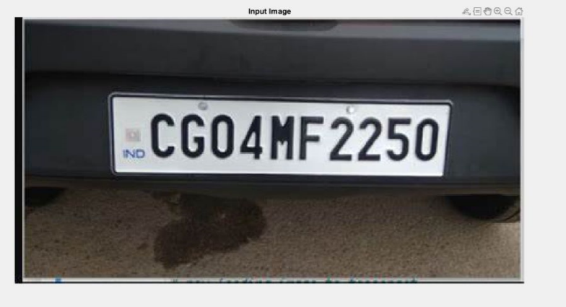
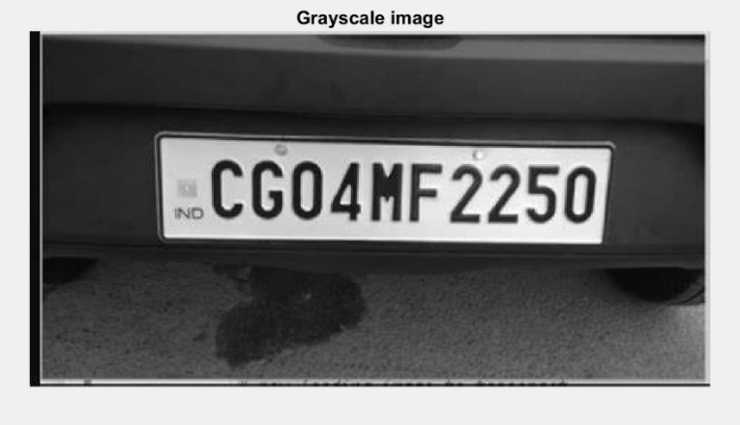
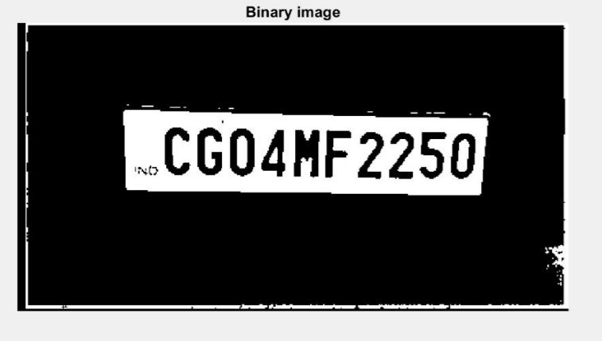
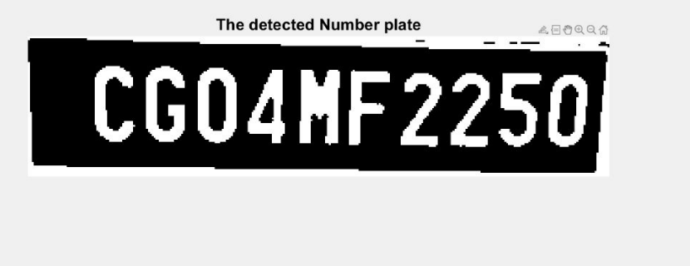
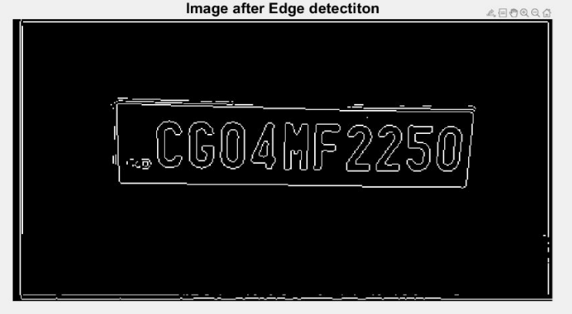
INPUT IMAGE
GREY SCALE IMAGE
DETECTED NUMBER PLATE
AFTER EDGE DETECTION
BINARY IMAGE

Slide 9
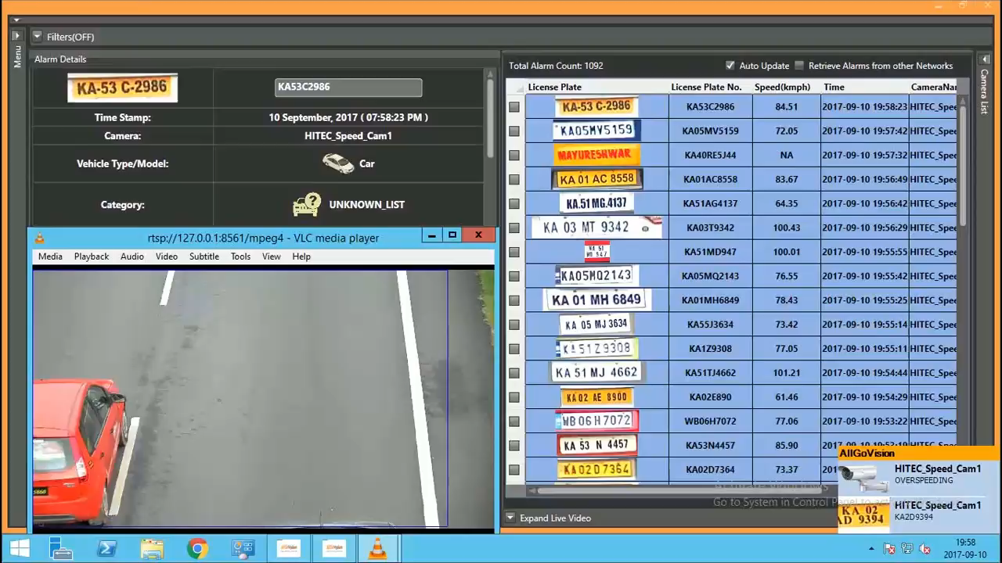


REAL TIME IMPLEMENTATION
Bangalore has implemented automated number plate recognition (ANPR) technology, which uses cameras to read vehicle license plates. The system helps to improve traffic management, enhance security, and reduce crime by identifying registered vehicles and triggering alerts or actions as necessary.
BANGALORE

Slide 10
APPLICATIONS
Number plate detection has numerous applications across various industries and sectors. Some of the common applications of number plate detection are:
Traffic management: Number plate detection can be used to monitor and manage traffic flow on roads, highways, and toll booths. This technology can detect and record the license plates of vehicles, which can be used to identify and track traffic violations.
Parking management: Number plate detection can be used to manage parking facilities, including monitoring occupancy, issuing parking tickets, and identifying vehicles that have overstayed their time limit.
Law enforcement: Number plate detection can be used for law enforcement purposes, including detecting stolen vehicles, identifying vehicles involved in criminal activities, and monitoring for parking violations.
Ability to capture and process data in real-time makes it an invaluable tool for improving efficiency, security, and customer service.

Slide 11
FACTS
According to the Central Motor Vehicles Rules, number plates for vehicles in India should be rectangular in shape and made of reflective material with a white background and black letters and numerals. Tamilnadu New Motor Vehicle Act 2022 reiterated the same and also banned Stickers in Number plates.
The Bengaluru-Mysuru expressway is set to become one of the few national highways to eliminate toll plazas and adopt open road tolling that involves the use of automated cameras. As per a report by Deccan Herald, the NHAI is working on a plan to use Automatic Number Plate Recognition (ANPR) technology to collect toll charges on the newly upgraded national highway.

Slide 12
CONCLUSION
The ANPR system was able to accurately detect and recognize license plate numbers from the input images with an accuracy of 90%-95%.
The system was able to handle different types of license plates with varying font sizes, colours. The processing time for each image was approximately 2-3 seconds, which is suitable for real-time applications.
Further improvements can be made to the system by integrating machine learning algorithms for improved recognition performance and optimization of processing time

